Slide 1
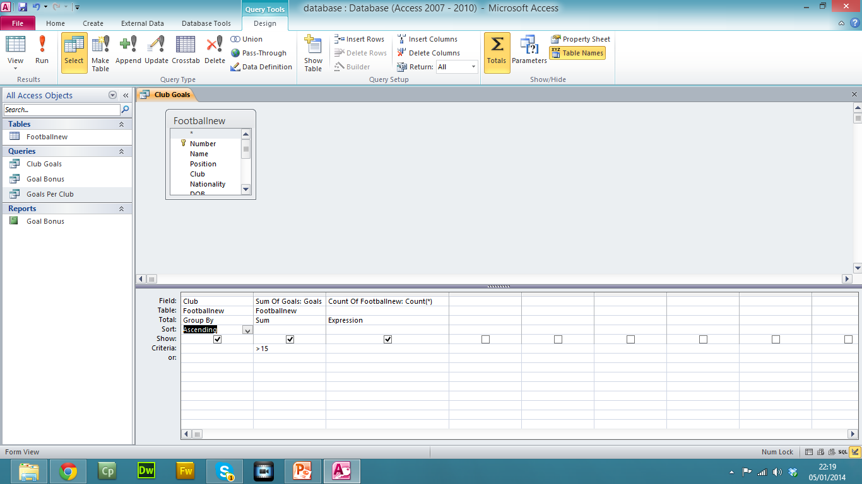
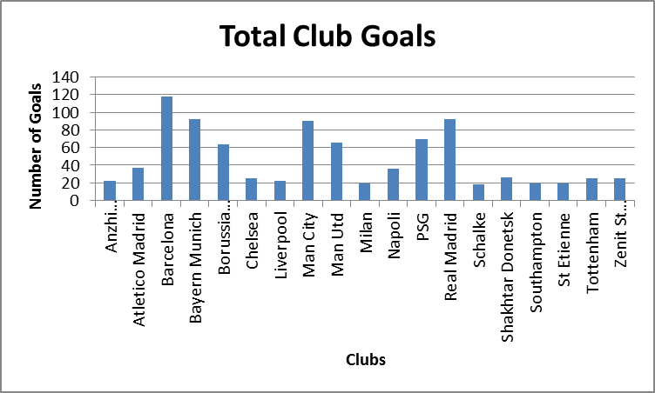
Create a new Query with the following Criteria: Make a query showing the following Fields: Club and Goals Sum up the total Goals for each club using the Summery Query Option and then select the count records check box. Only find the records with > 15 goals Sort the clubs into Ascending order Export the query into an spreadsheet software. Make sure you save the query before you export
Create a graph using a suitable spreadsheet software: Select the first two columns and create a simple bar chart. Delete the legend Title: Total Club Goals Horizontal Axis Title: Clubs Vertical Axis Title: Number of Goals

